Slide 1
Multispectral Object Detection using DETR
Alan Devkota, Jayson Varughese, Utkarsh Gupta, Yidan Shen

Slide 2
Table of Contents
Introduction
Application
Related work
Dataset
Challenges
Transformer Architecture
Methodology
Results
Future Work
References

Slide 3
Introduction
Multispectral data for object recognition and location
Cross-attention
Detection Transformers (DETR)

Slide 4
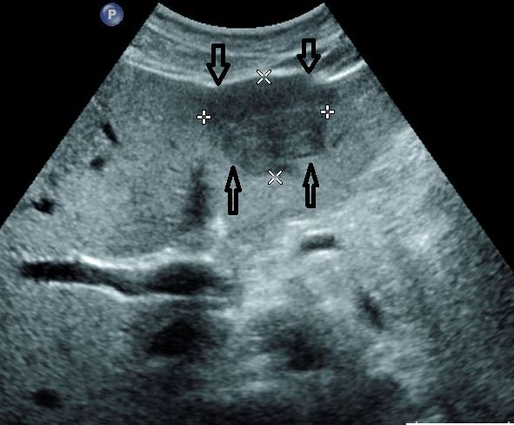
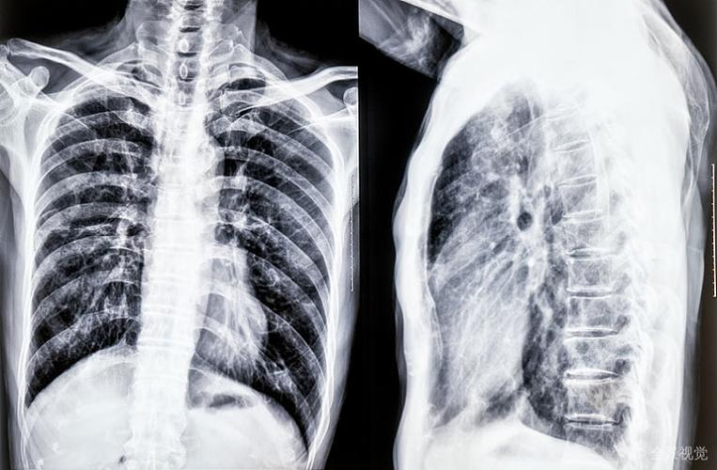
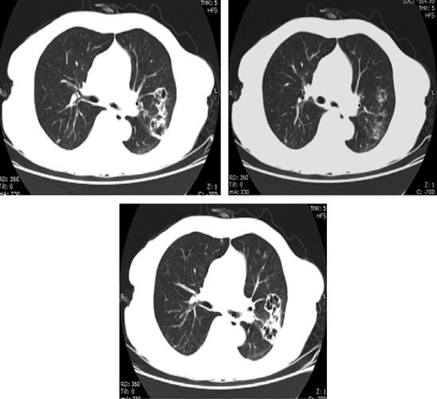
Application
Healthcare– patient diagnosis (UltraSound, CT, X-rays)

Slide 5


Application
Medication (text based modality), test, daily routine dataset (Tabular text)

Slide 6
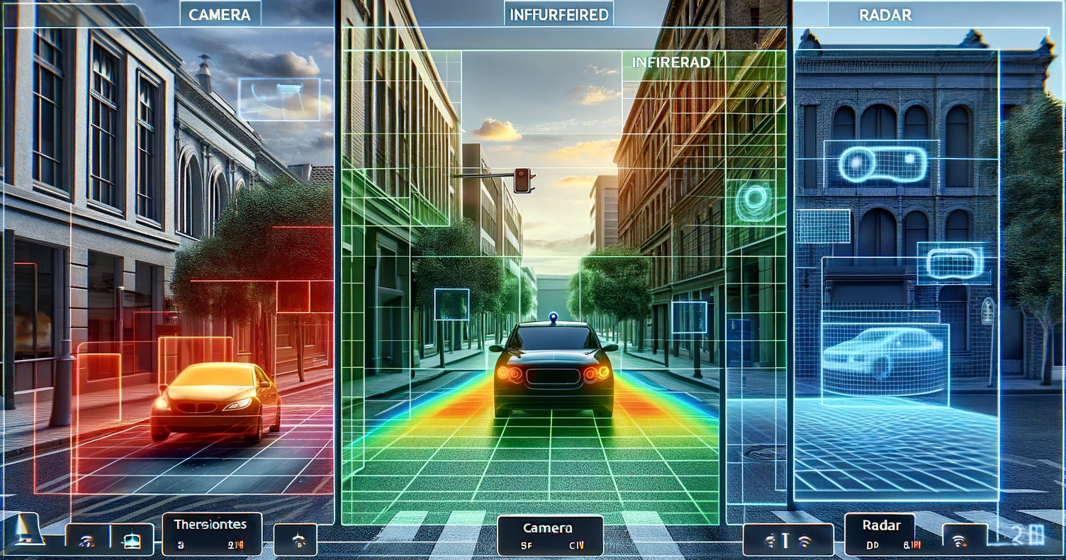
Application
Autonomous driving (camera, IR, radar)

Slide 7
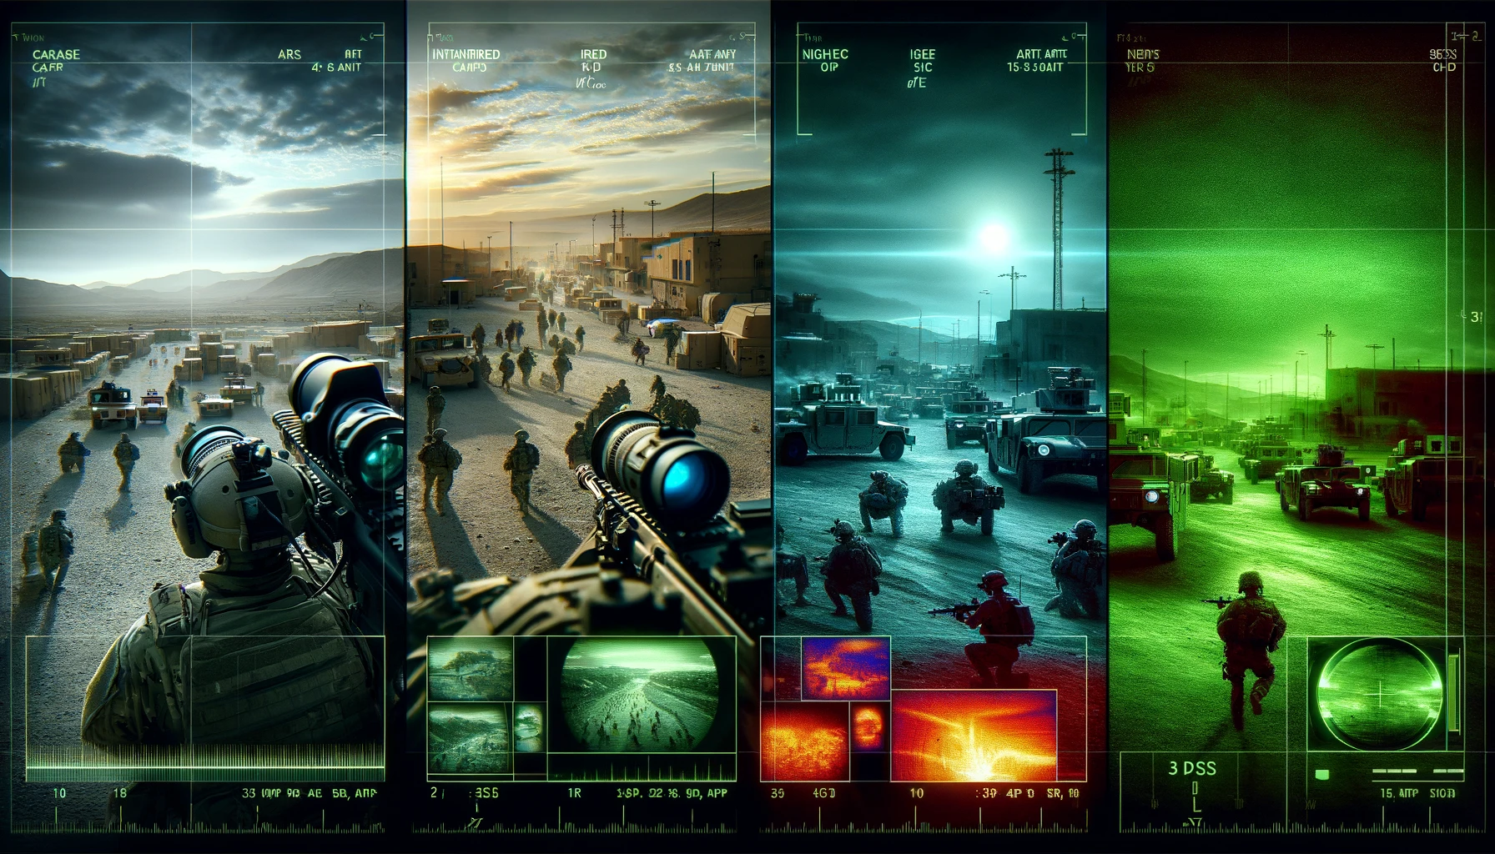
Application
Military reconnaissance (camera, IR, night-vision equipment)

Slide 8
Related work
End-to-End Object Detection with Transformers
Object detection method using transformer architecture, achieving an end-to-end process.
Simplifies object detection by directly predicting without needing region proposals or complex feature extraction.
Utilizes the transformer's self-attention mechanism to better adapt to different object sizes, shapes, and understand global context.
Implements bipartite matching algorithm in training to streamline model-ground truth object associations.

Slide 9
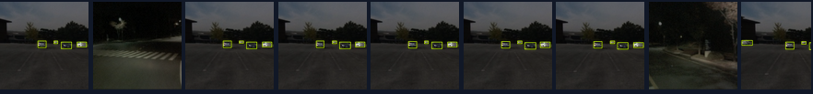
Dataset
KAIST Dataset:
Multispectral pedestrian detection dataset.
Developed by Korea Advanced Institute of Science and Technology.
Includes visible light and infrared images.
Captured during various times, weather, and lighting conditions.
Utilized for advanced computer vision algorithms.
Applicable in autonomous driving and urban surveillance.
Aids in pedestrian identification and tracking.
Addresses complex environments and diverse spectral characteristics.
However, it is in xml format and is incompatible with original DETR.

Slide 10
Challenges
KAIST dataset annotations differ from DETR's COCO format.
Original DETR model requires modification for the encoder.
Determining layer count and attention in encoders.
Hard to find fully aligned multimodal datasets, unannotated ones need pre-processing.
Training on small datasets yields poor results, large datasets needed.
Uses DETR architecture with 2 parallel modalities, requiring token concatenation in encoders/decoders.
Matching tensor dimensions in each layer for multimodal dataset is challenging.
Notes:
To use pre-trained weights and models during training of a transformer, we need to create model with same structure (i.e., same layers, where each layers has same number of input and output features, feature dimension, embedding size). Therefore it is difficult to make modification to original DETR structure for multiple modalities.

Slide 11
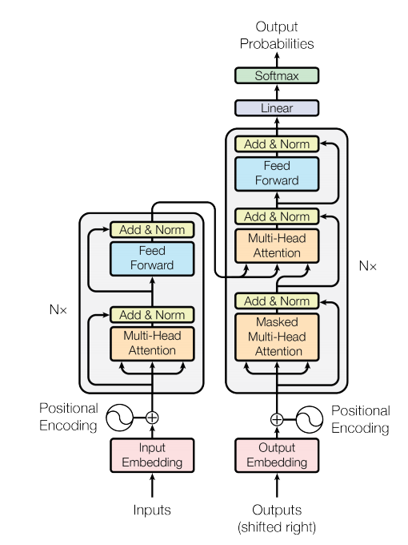
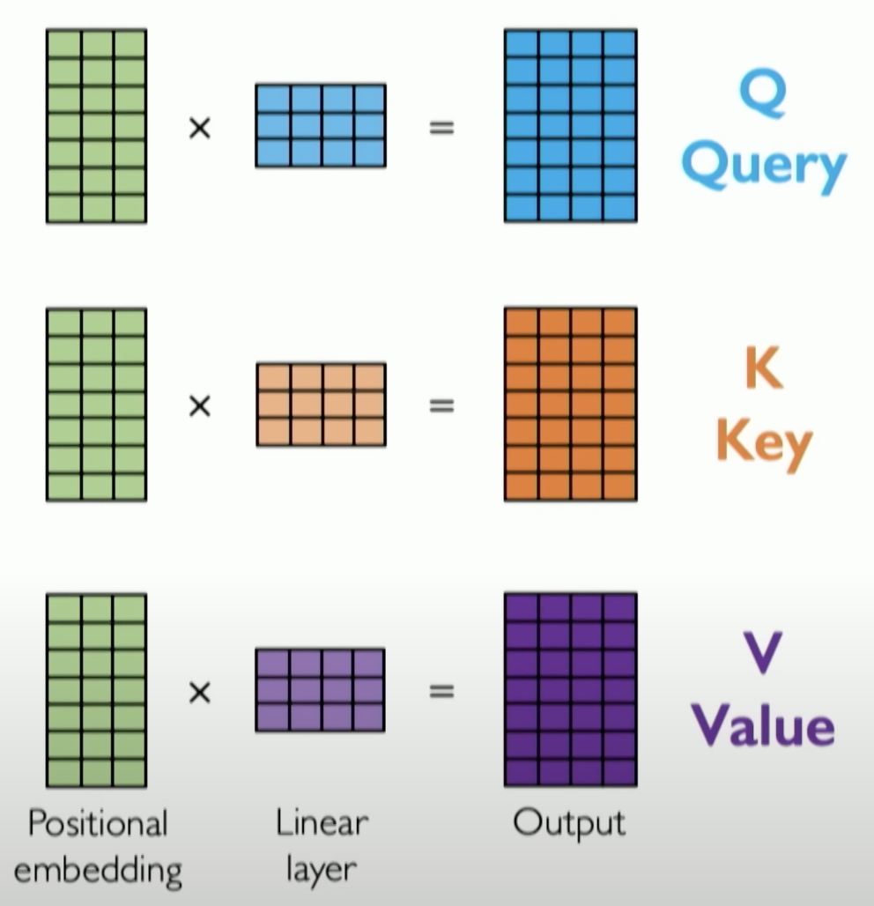
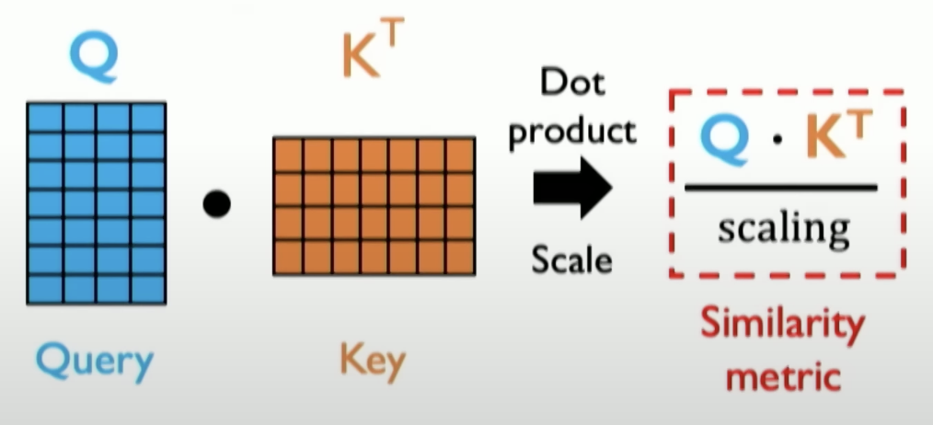
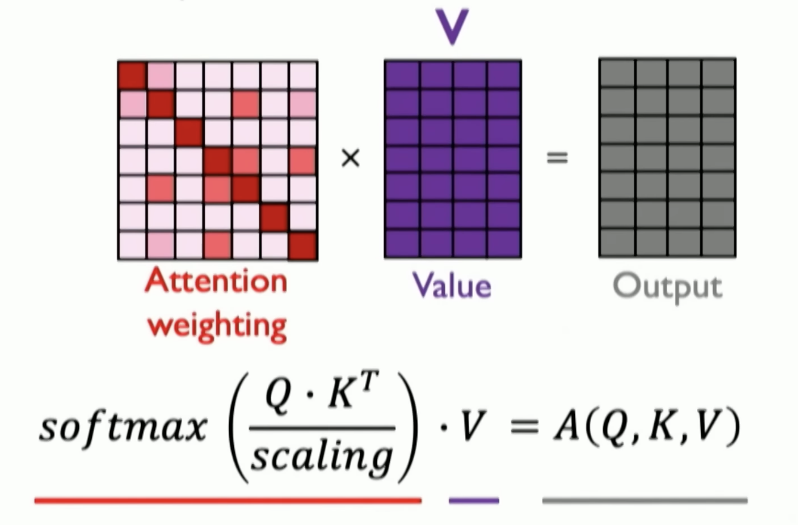
Attention is all you need
Self Attention Mechanism used in transformer
Notes:
Transformers are a type of neural network architecture introduced in the paper "Attention is All You Need" by Vaswani in 2017.
It was initially designed for sequence-to-sequence tasks in natural language processing (NLP) but has been used in many other applications since then.
Transformers address limitations of traditional architectures such as RNNs, LSTMs, and CNNs in capturing long-range dependencies in sequences.
For eg. RNNs have no parallelization, they had to be computed one time step at a time.
Transformers on the other hand have parallelization built into their architecture.
However, they do not inherently understand the order of elements in a sequence.
Which is why we add positional encodings to the input embeddings to provide information about the element's position.
The self attention mechanism is how transformers achieve their long range dependencies. Which is done by using Q,K and V.
Queries and keys are used to compute the attention scores, these indicate how much focus should be given to each element in the sequence concerning the query. This is done by calculating the cosine similarity between the two vectors.
Value vector is then multiplied by the attention scores to obtain a weighted sum. This weighted sum represents the contribution of each element in the sequence to the final output.
Multiple of these self attention mechanisms can be combined together to form multi head attention which can cater to different parts of the input.

Slide 12
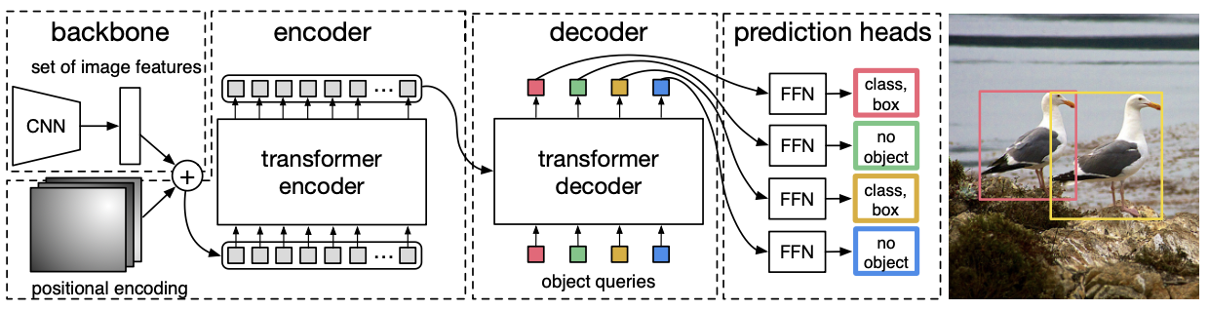
DETR Architecture
CNN Backbone
Encoder - Decoder transformers
Feed forward network (FFN)
Notes:
Before DETR, Region Proposal Network was used for object detection tasks which relied on predefined anchor boxes, two stage processing and it could only predict a set number of objects.
DETR eliminates these issues
As we can see detr architecture has inputs that are fed into a Convolutional Neural Network such as ResNet50 for feature extraction.
It then goes through the encoder where it extracts the hierarchical features from the input image.
It divides the feature map into a fixed number of non-overlapping spatial locations, treating each location as a separate entity.
After this the decoder processes the spatial locations in parallel, treating them as individual objects and generates a set of object queries representing the potential objects in the image.
As we can see it produces the classification and bounding boxes in one go at the output after passing through feed forward networks
To discuss our experimental methodology Yidan will be taking over.

Slide 13
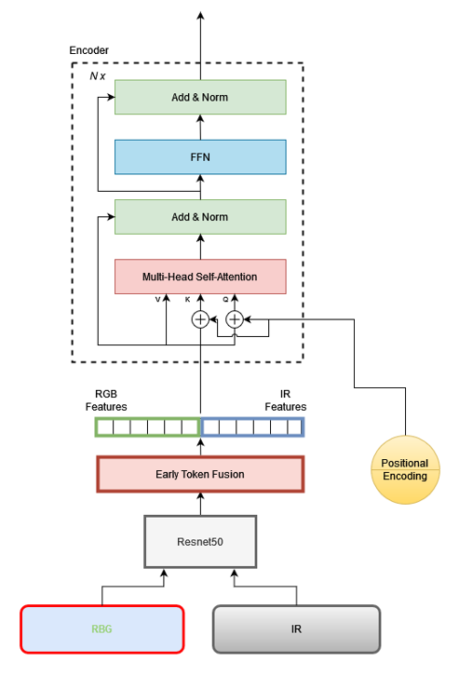
Methodology (1st stage)
Two modalities
RGB
IR
Feature extract
Resnet-50
FFN
Encoder
Multi-head Self-attention
FFN
Positional Encoding
DetrSinePositionalEmbedding
Notes:
INPUT Go through Feature extract part
Fuse & flatten the features to pass it to the transformer encoder
add positional encoding To retain 2D information of each features

Slide 14
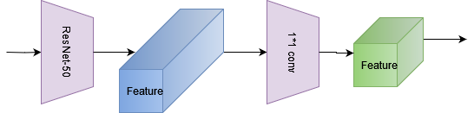
Methodology (1st stage)
ResNet-50
Notes:
then we use 1x1 convolution to reduce the number of channels

Slide 15
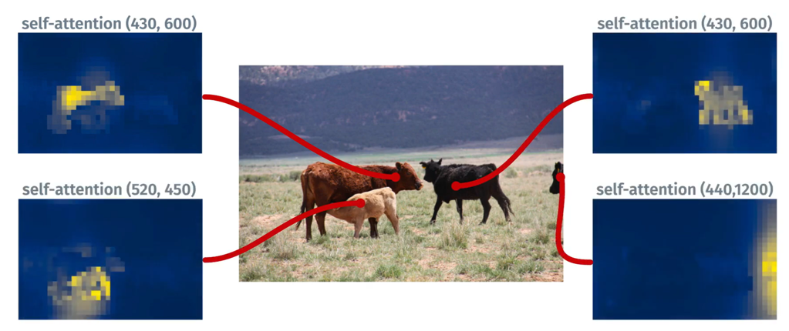
Methodology (1st stage)
Role of encoder
Pixel belonging to same image have high attention
Repeat for other source points
Notes:
encoder is able to separate individual instances.

Slide 16
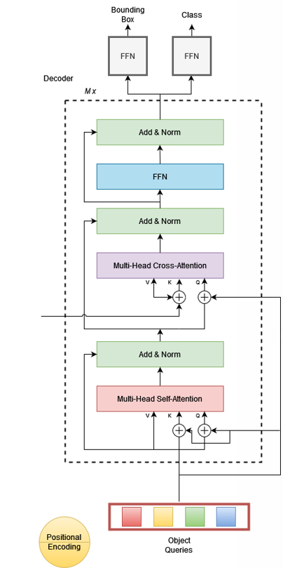
Methodology (2nd stage)
Object queries
Decoder
Multi-head Self-attention
Multi-head Cross-attention
FFN
FFN
Bounding box
Class
Positional Encoding
DetrSinePositionalEmbedding
d*HW
d*N
Notes:
fixed set of learnable encoding called object queries would attend (cross-attention) with previous keys and values from encoder.
Object queries would detect corresponding object in the encoder features.

Slide 17
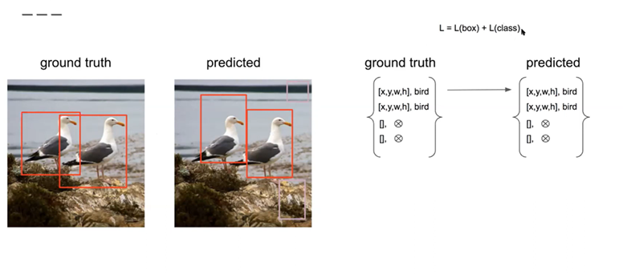
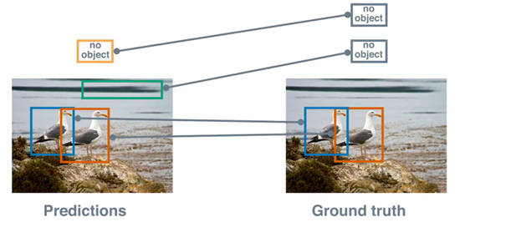
Methodology (2nd stage)
Bipartite Matching
Hungarian algorithm
Notes:
Prediction set

Slide 18
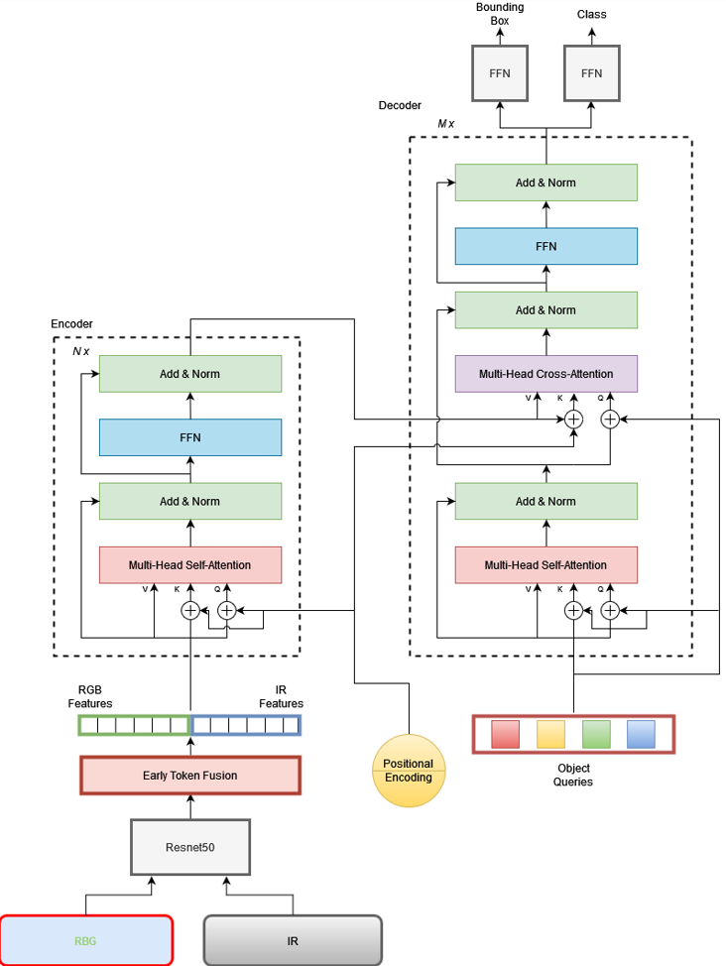
Methodology
Notes:
Complete flow chart from input to output

Slide 19
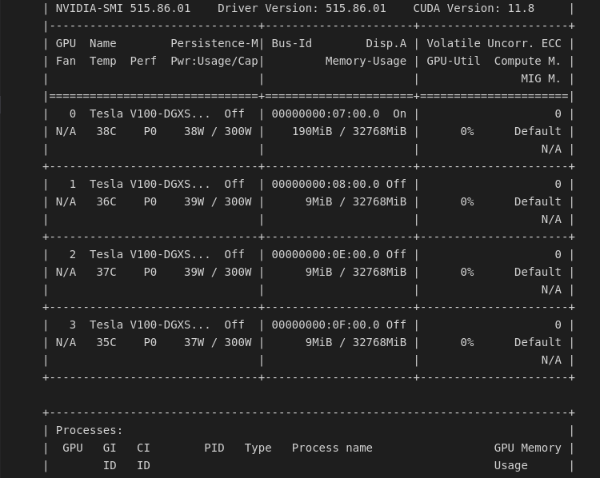
Environment

Slide 20
Settings
Input image: 512x640
Resnet 50, 6 x DETR encoder layers, 6 x DETR Decoder layers, two classifier layers.
Settings:
Number of epoch for training = 50, logs will be written every 5 steps.
Trained on Tesla V100
Initial learning rate = 1*10^-4 for main part, 1*10^-5 for backbone, weight decay used for regularization = 1*10^-5 (learning rate scheduler would change these rates)
Total 41.5 M parameters, 41.3 M are trainable , 222K are non-trainable, Total estimated size of model parameters = 116.01 MB

Slide 21
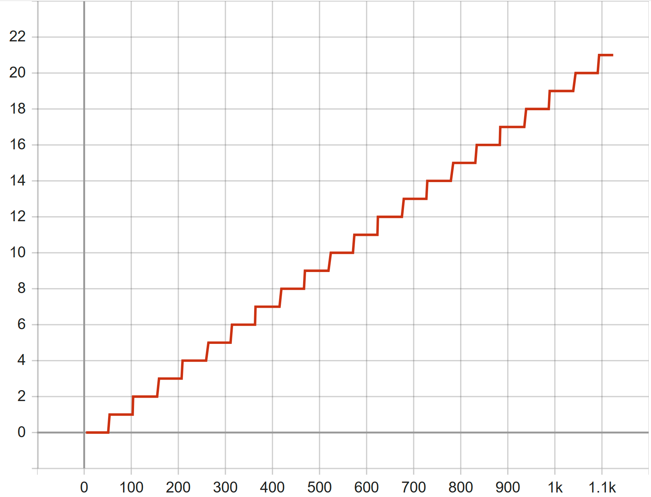
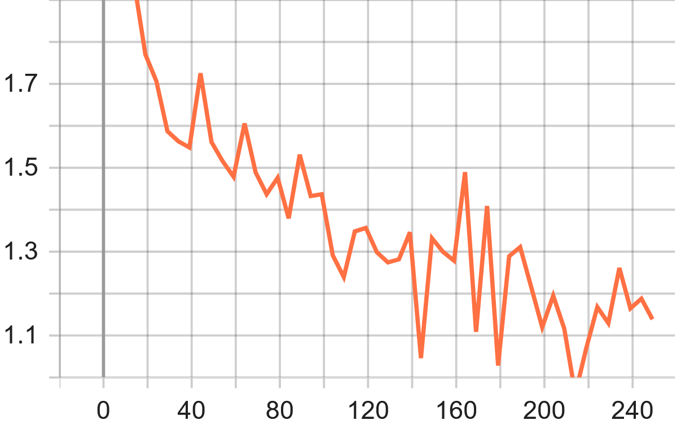
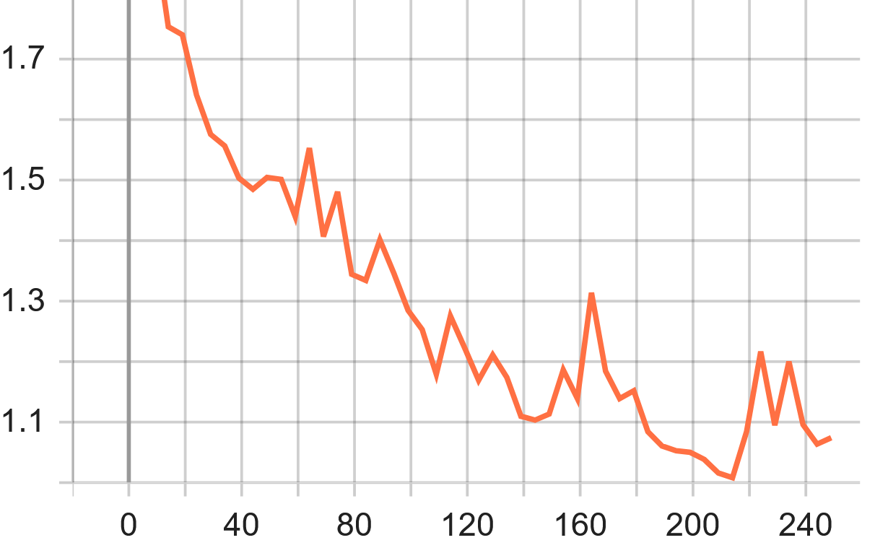
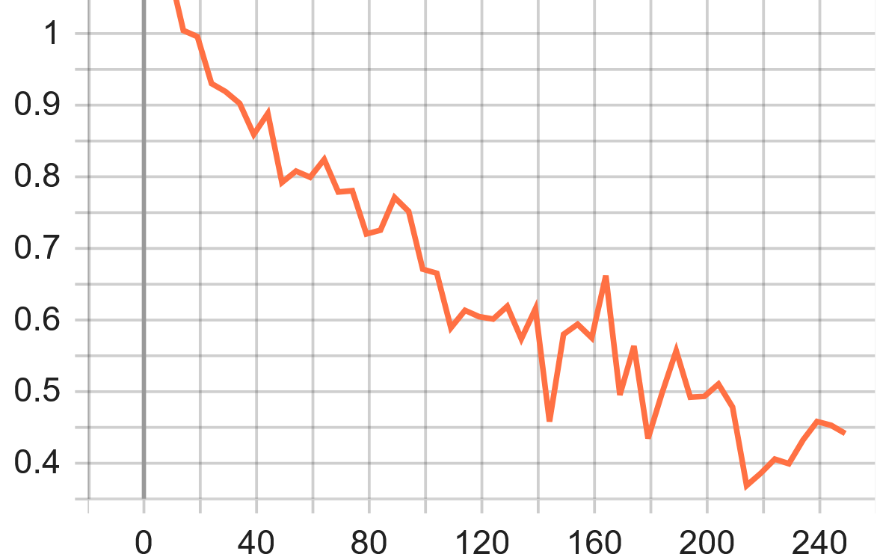
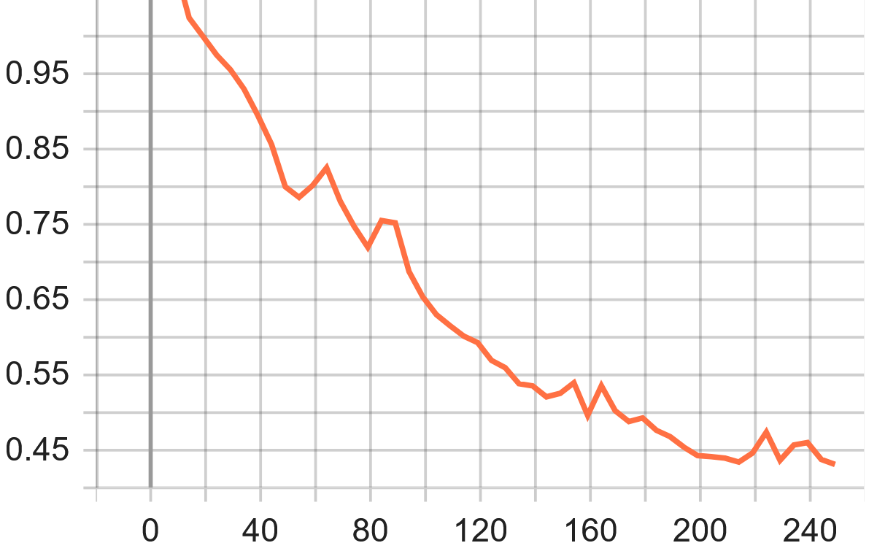
Results
epoch
training_loss
validation_loss
train_loss_ce
validation_loss_ce

Slide 22
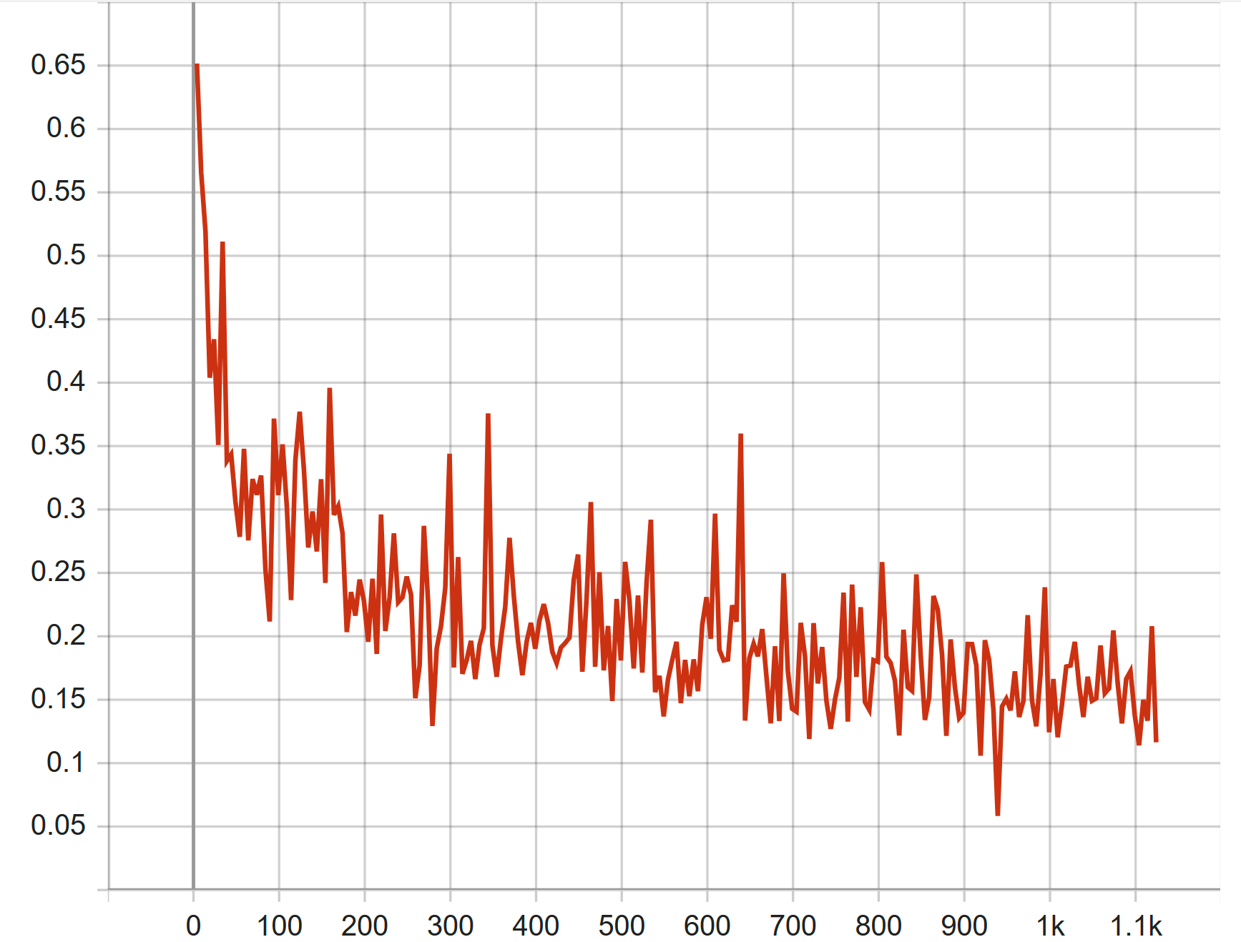
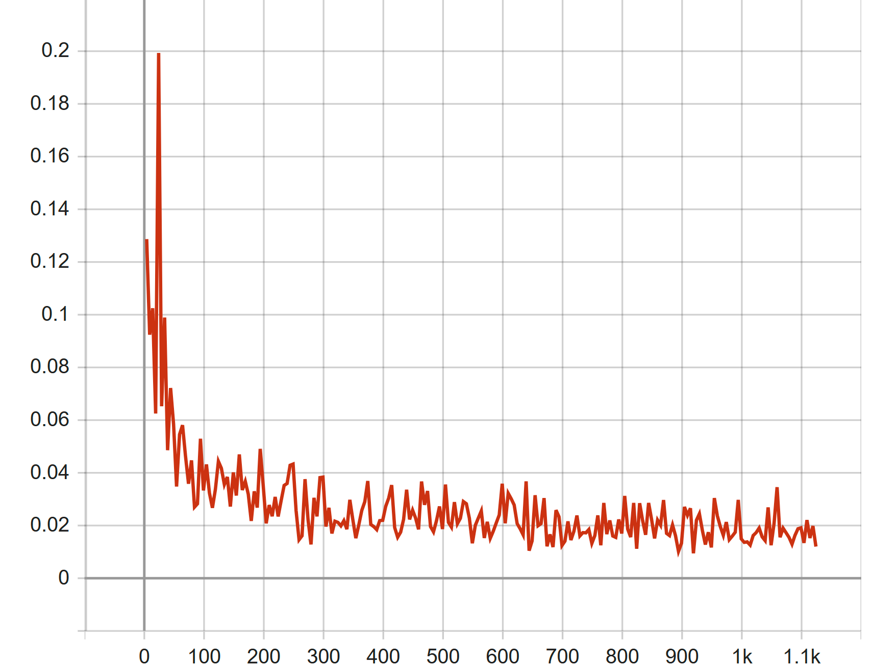
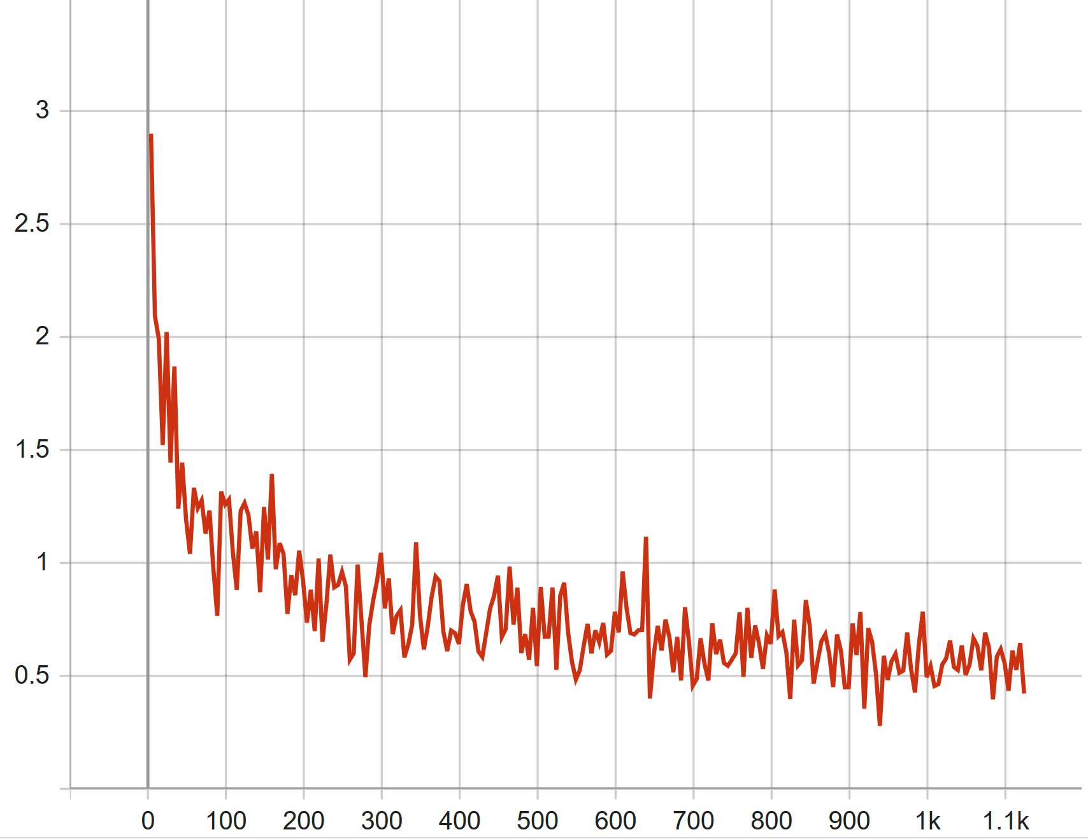
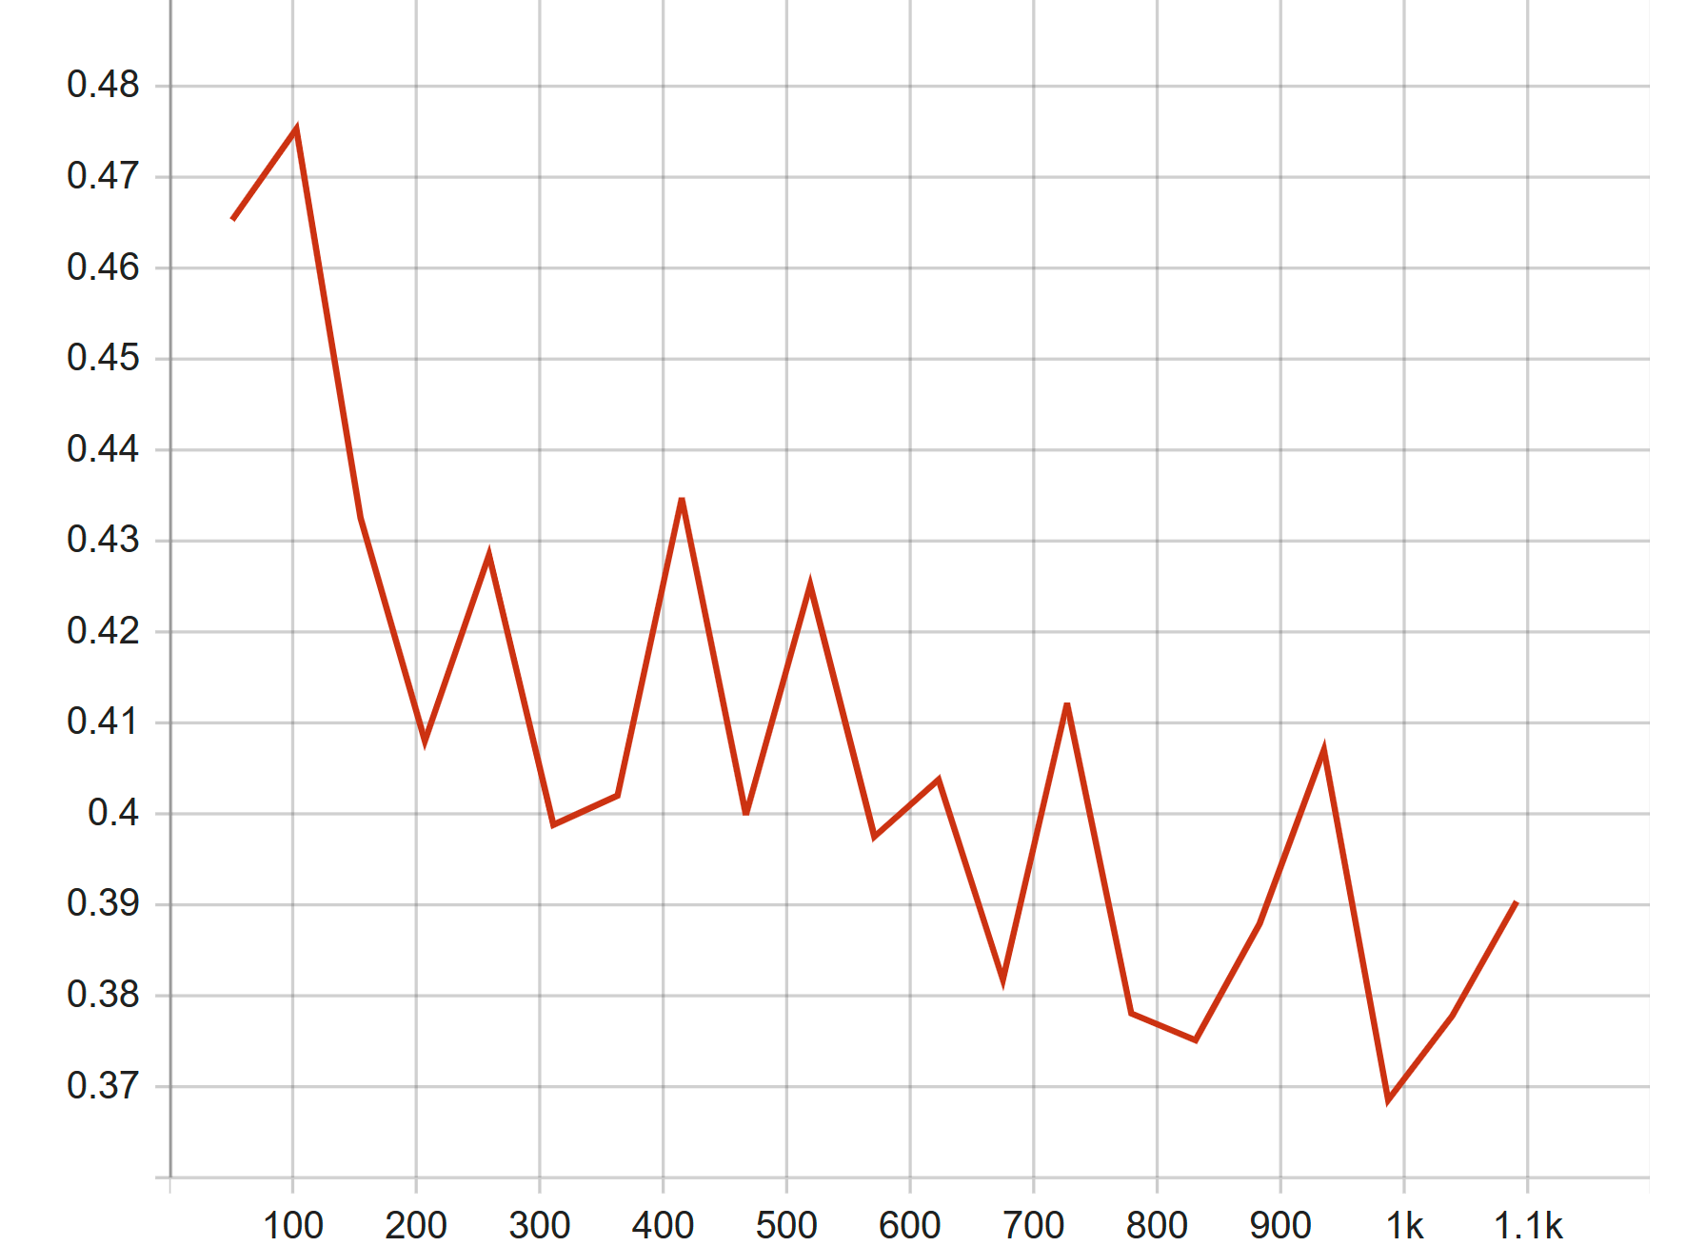
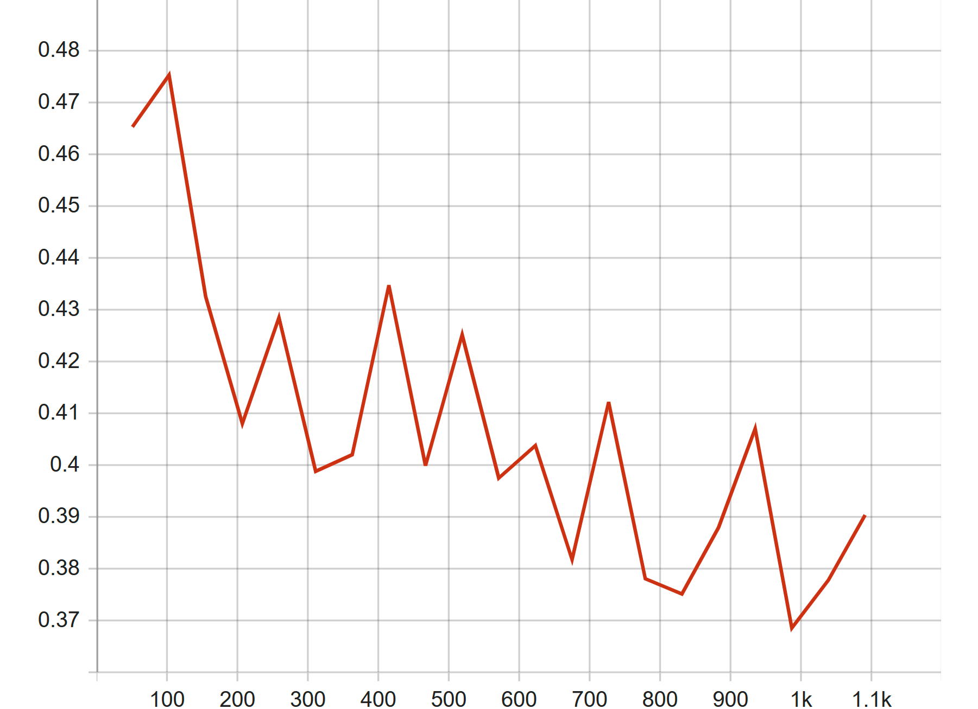
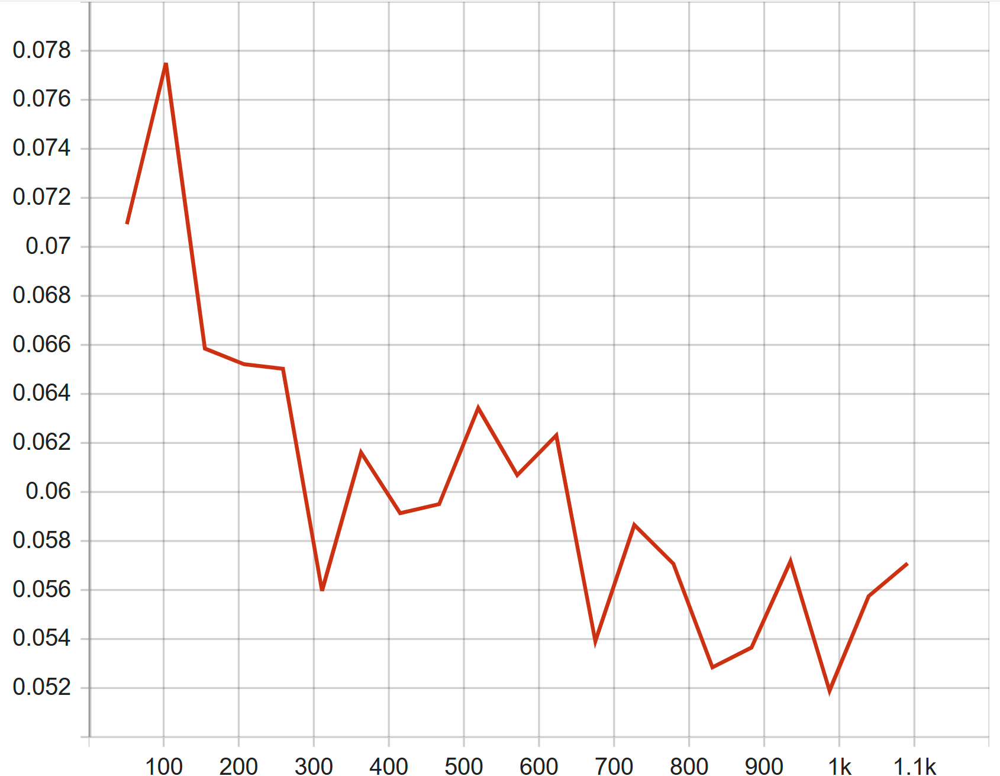
Results
train_loss_giou
training_loss
train_loss_bbox
validation_loss
validation_loss_bbox
validation_loss_giou

Slide 23
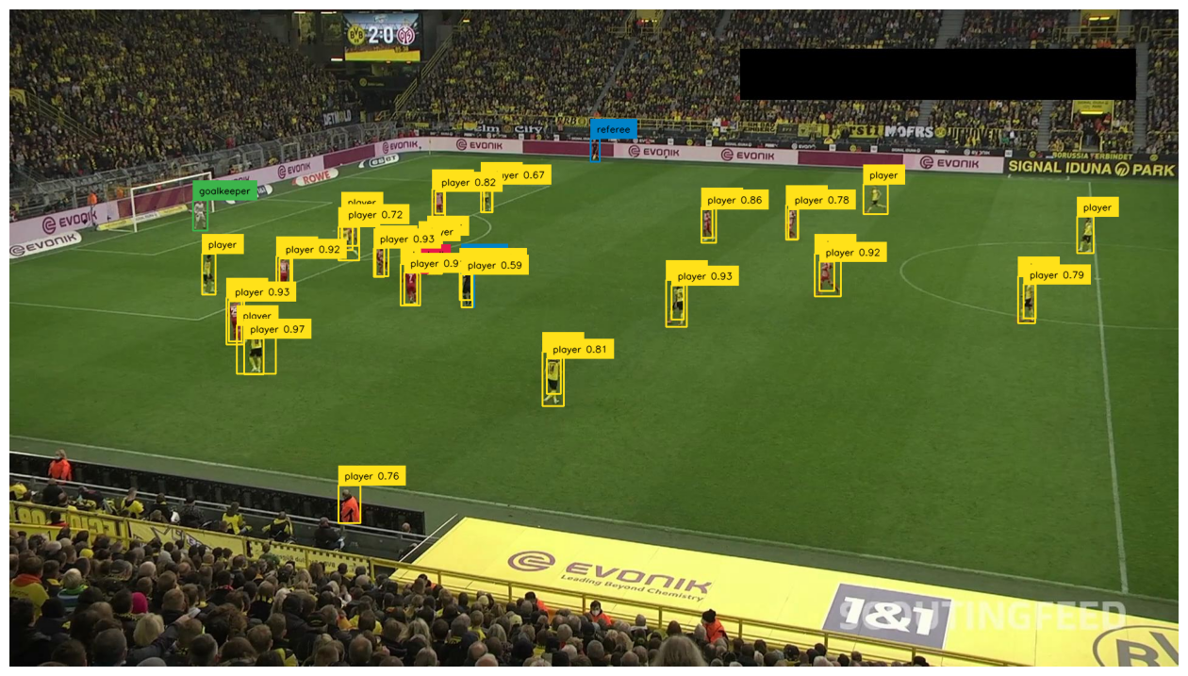
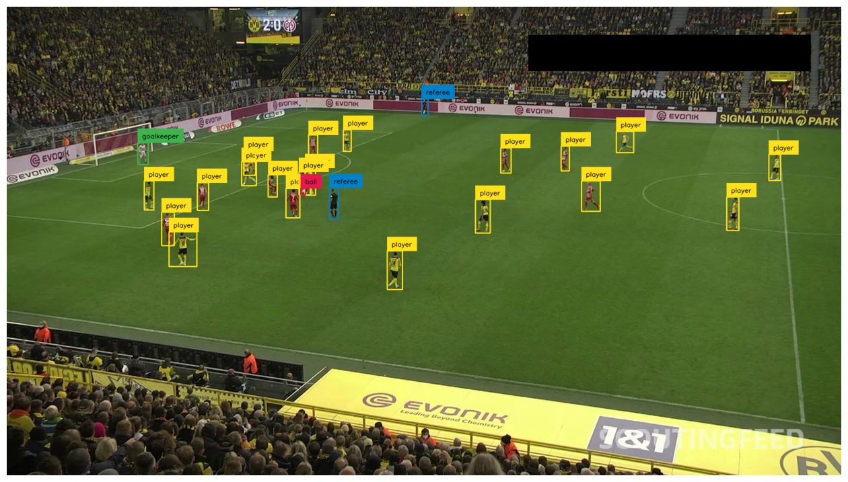
Results
image_comp_actual_detected
image_compared_to_detection

Slide 24
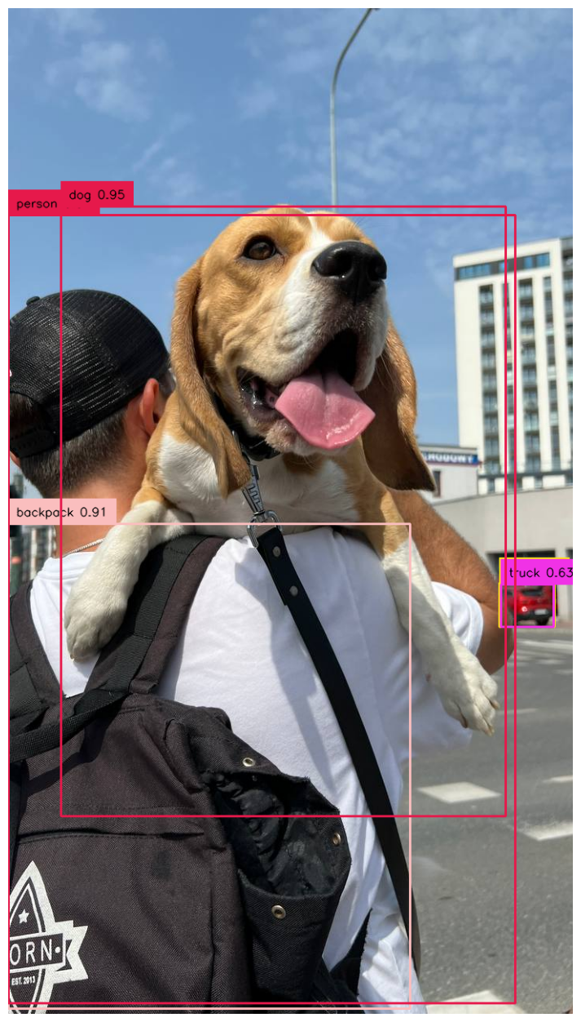
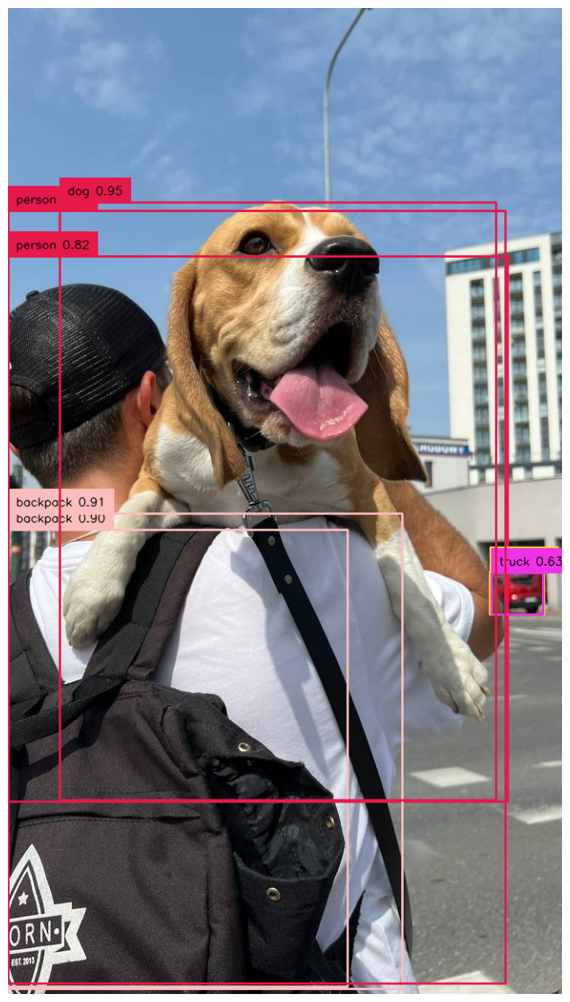
Results
Initial with NMS
Initial without NMS

Slide 25
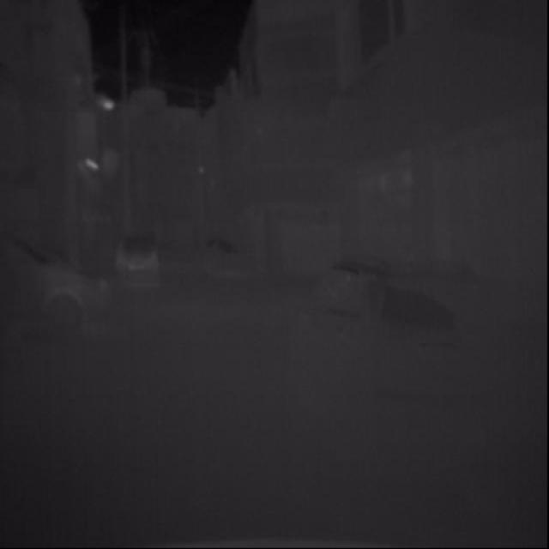
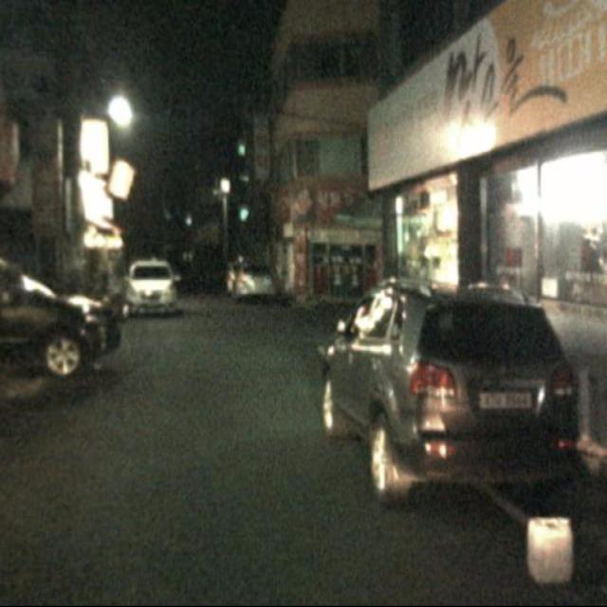
Example of dataset
IR Image
RGB Image

Slide 26
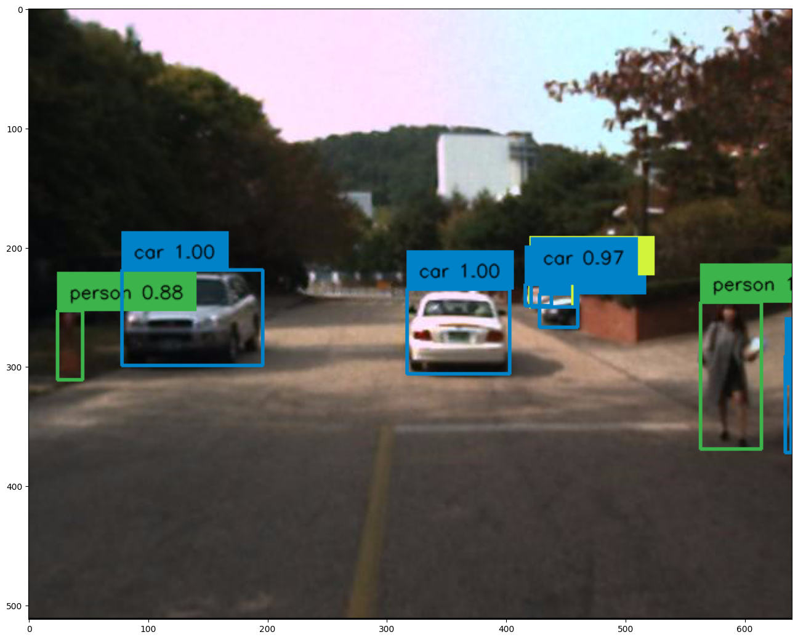
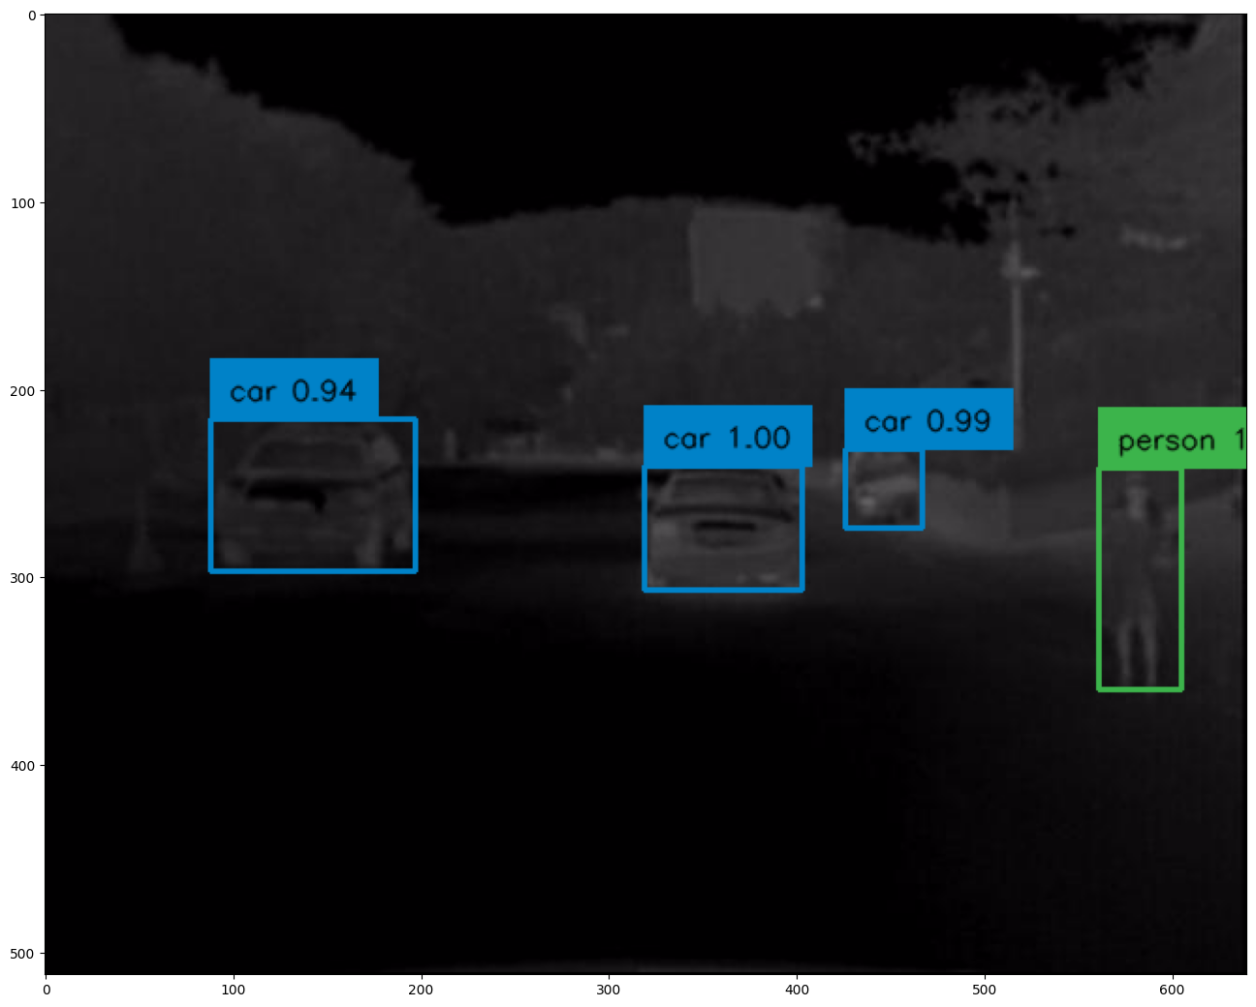
Results

Slide 27
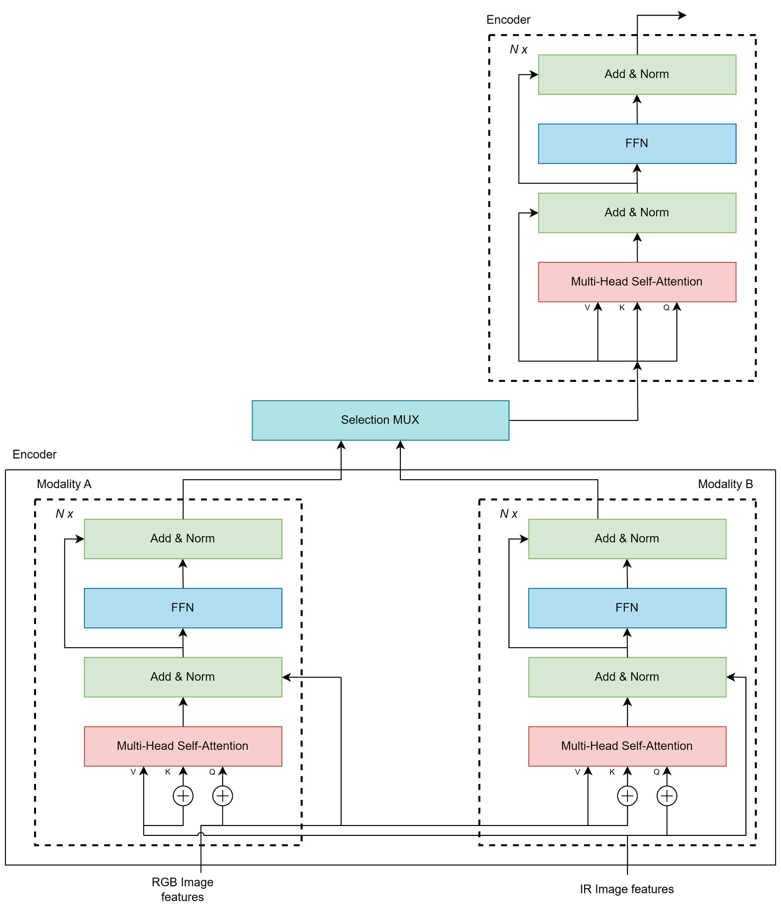
Future Work
Extend the two modalities to three modalities
New architecture use two encoders
Notes:
Give examples of different possible modalities.

Slide 28
References
[1]. Carion, N., Massa, F., Synnaeve, G., Usunier, N., Kirillov, A., & Zagoruyko, S. (2020). End-to-End Object Detection with Transformers. arXiv preprint arXiv:2005.12872.
[2]. Cai, Z., Vasconcelos, N.: Cascade R-CNN: High quality object detection and instance segmentation. PAMI (2019)
[3]. Glorot, X., Bengio, Y.: Understanding the difficulty of training deep feedforward neural networks. In: AISTATS (2010)
[4]. He, K., Girshick, R., Doll´ar, P.: Rethinking imagenet pre-training. In: ICCV (2019)
[5]. He, K., Zhang, X., Ren, S., Sun, J.: Deep residual learning for image recognition. In: CVPR (2016)
[6]. Hosang, J.H., Benenson, R., Schiele, B.: Learning non-maximum suppression. In: CVPR (2017)
[7]. Hu, H., Gu, J., Zhang, Z., Dai, J., Wei, Y.: Relation networks for object detection. In: CVPR (2018)
[8]. Kirillov, A., Girshick, R., He, K., Doll´ar, P.: Panoptic feature pyramid networks. In: CVPR (2019)
[9]. Kuhn, H.W.: The hungarian method for the assignment problem (1955)
[10]. Lin, T.Y., Goyal, P., Girshick, R.B., He, K., Doll´ar, P.: Focal loss for dense object detection. In: ICCV (2017)
[11]. Lin, T.Y., Maire, M., Belongie, S., Hays, J., Perona, P., Ramanan, D., Doll´ar, P., Zitnick, C.L.: Microsoft COCO: Common objects in context. In: ECCV (2014)
[12]. Paszke, A., Gross, S., Massa, F., Lerer, A., Bradbury, J., Chanan, G., Killeen, T., Lin, Z., Gimelshein, N., Antiga, L., Desmaison, A., Kopf, A., Yang, E., DeVito, Z., Raison, M., Tejani, A., Chilamkurthy, S., Steiner, B., Fang, L., Bai, J., Chintala, S.: Pytorch: An imperative style, high-performance deep learning library. In: NeurIPS (2019)
[13]. Ren, S., He, K., Girshick, R.B., Sun, J.: Faster R-CNN: Towards real-time object detection with region proposal networks. PAMI (2015)
[14]. Salvador, A., Bellver, M., Baradad, M., Marqu´es, F., Torres, J., Gir´o, X.: Recurrent neural networks for semantic instance segmentation. arXiv:1712.00617 (2017)
[15]. Tian, Z., Shen, C., Chen, H., He, T.: FCOS: Fully convolutional one-stage object detection. In: ICCV (2019)
[16]. Vaswani, A., Shazeer, N., Parmar, N., Uszkoreit, J., Jones, L., Gomez, A.N., Kaiser, L., Polosukhin, I.: Attention is all you need. In: NeurIPS (2017)
[17]. Zhou, X., Wang, D., Kr¨ahenb¨uhl, P.: Objects as points. arXiv:1904.07850 (2019)

Slide 29
Thank You

Slide 30
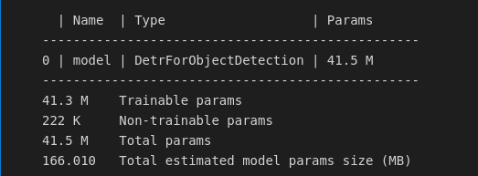
Miscellaneous
Input image: 512x640
Resnet 50, 6 x DETR encoder layers, 6 x DETR Decoder layers, two classifier layers.
Settings:
Number of epoch for training = 50, logs will be written every 5 steps.
Trained on Tesla V100
Initial learning rate = 1*10^-4 for main part, 1*10^-5 for backbone, weight decay used for regularization = 1*10^-5 (learning rate scheduler would change these rates)

